Slide 1





STRATEGIC SITES INVENTORY PROGRAM OVERVIEW
SSI PROGRAM CONDUCTED BY

Slide 2

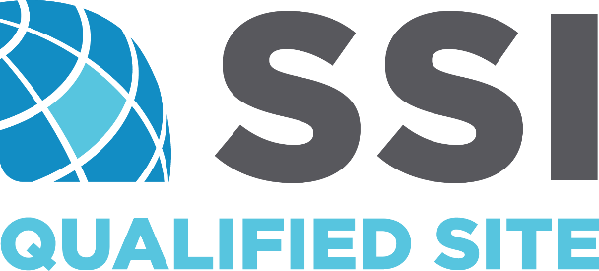
IEDC
STRATEGIC SITES
INVENTORY PROGRAM
NEXT LEVEL BUSINESS
  Increase community competitiveness
  in economic development by strengthening the quality of industrial and commercial real estate asset inventories.

Slide 3
Community Competitiveness
IEDC
STRATEGIC SITES
INVENTORY PROGRAM
NEXT LEVEL BUSINESS
  One of the largest limiting factors a community faces in winning quality economic development projects in today’s highly competitive marketplace is availability of quality sites.

Slide 4
Community Competitiveness
IEDC
STRATEGIC SITES
INVENTORY PROGRAM
NEXT LEVEL BUSINESS
  The Strategic Sites Inventory Program (SSI) identifies new, undiscovered sites with potential for economic development.
IT DOES NOT DO ANY OF THE FOLLOWING
Not a land grab or eminent domain project from the state
Not a threat to the local service providers or developers
Not meant to collect soil samples, surveys or analysis at this stage

Slide 5
Community Competitiveness
IEDC
STRATEGIC SITES
INVENTORY PROGRAM
NEXT LEVEL BUSINESS
  The Strategic Sites Inventory Program (SSI) identifies new, undiscovered sites with potential for economic development.
IT DOES NOT DO ANY OF THE FOLLOWING
Replace or compete with sites and buildings database (ZoomProspector)
Replace or compete with IN Site Certified Program
Compete with local consulting firms

Slide 6
Community Competitiveness
IEDC
STRATEGIC SITES
INVENTORY PROGRAM
NEXT LEVEL BUSINESS
  The Strategic Sites Inventory Program (SSI) identifies new, undiscovered sites with potential for economic development.
IT DOES DO THESE THINGS
Utilizes existing GIS data and public sources to identify tracts with potential
Layers in flood plain, ownership and infrastructure data
to find suitable tracts
Brings local community together to gauge interest for bringing new sites to market

Slide 7
Community Competitiveness
IEDC
STRATEGIC SITES
INVENTORY PROGRAM
NEXT LEVEL BUSINESS
  The Strategic Sites Inventory Program (SSI) identifies new, undiscovered sites with potential for economic development.
IT DOES DO THESE THINGS
Feed IN certified sites program
Create consulting opportunities for local firms
  Engineering
  Environmental/ecological
  Title abstracting/appraisal
  Real estate brokers

Slide 8
Community Competitiveness
IEDC
STRATEGIC SITES
INVENTORY PROGRAM
NEXT LEVEL BUSINESS
  Why is the IEDC working with Leotta Location+Design,
  a Louisiana-based firm?
LL+D conducted numerous successful industrial site selection projects in Louisiana in its oil & gas-driven energy sector including the largest FDI project in U.S. history: the Sasol, Ltd. MegaProject
LL+D’s SSI Program has had success in twelve states including Florida and the Carolinas identifying new potential quality sites
Duke Energy has territory in these locations as well as Indiana and has realized significant results
Indiana would be among a select group of early adopters to build sites pipeline through the SSI Program
Competitive sites inventory is key in landing new economic development projects
LL+D is working directly with members of the Site Selector’s Guild to ensure quality site availability with SSI Program adopters

Slide 9
Community Competitiveness
IEDC
STRATEGIC SITES
INVENTORY PROGRAM
NEXT LEVEL BUSINESS
  Who is paying for this program and are there any costs
  to the local community?
IEDC is paying for initial identification of potential sites for all 92 Indiana counties
Power Partners are included to review the data in their territories at no cost
There is no cost to LEDOS and their stakeholder
IEDC has funded the first year access to the SSI Portal

Slide 10
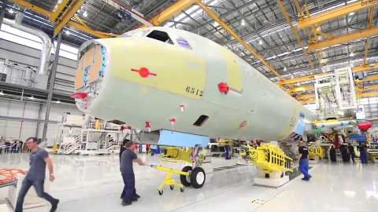
IEDC
NEXT LEVEL BUSINESS

Slide 11
Community Competitiveness
IEDC
STRATEGIC SITES
INVENTORY PROGRAM
NEXT LEVEL BUSINESS
  OVERVIEW FROM EXPERIENCE AND SUCCESS
ENTERPRISE FLORIDA, INC.
SSI Phase I conducted for 59 of 67 counties
1,247 potential high-quality sites identified for
  Megasite, heavy industrial, light industrial, agribusiness, distribution/freight logistics, R&D/technology, and business park/medical project land uses
38 sites have completed and survived SSI Phase II: Preliminary Due Diligence
Significant new project have be won locating on virgin SSI Program sites

Slide 12
Community Competitiveness
IEDC
STRATEGIC SITES
INVENTORY PROGRAM
NEXT LEVEL BUSINESS
  OVERVIEW FROM EXPERIENCE AND SUCCESS
LL+D
Using GIS data and years of industrial and commercial site selection experience to bring together local communities to find sites with hidden potential
LL+D team disciplines include:
  Engineering
  Environmental/ecological

Slide 13



TESTIMONIALS
IEDC
NEXT LEVEL BUSINESS
SSI Program Experience: SSI Phase I for megasite, heavy industrial, light industrial, heavy agribusiness, general agribusiness, distribution/freight logistics, R&D/tech, and business park/medical for fifteen counties across North Florida. SSI Phase II for four sites in Duke Energy Florida service area.
“The Strategic Sites Inventory (SSI) program got its start in Florida through a seed grant from the Duke Energy Foundation to Enterprise Florida in January 2014. Since that time, Enterprise Florida, Duke Energy, FPL, Gulf Power and several communities have made additional investments to further the development of product in the state through SSI. This program has resulted in the discovery of over 1,000 potential sites for new business in Florida and has launched a new culture in our state for competitive sites. At Duke Energy, we greatly value the positive impact the SSI program is having on the communities we serve to attract new jobs and capital investment.”
Marc Hoenstine, CEcD
Director, Florida Economic Development
…the Strategic Site Inventory Program will greatly assist our economic development professionals in delivering quality sites in a timely manner…
INVESTOR-OWNED ELECTRIC UTILITY

Slide 14


TESTIMONIALS
IEDC
NEXT LEVEL BUSINESS
SSI Program Experience: SSI Phase I for megasite, heavy industrial, light industrial, heavy agribusiness, and general agribusiness for thirty-six counties across central and south Alabama.
“Victor and the Leotta Location and Design team did an outstanding job in helping our communities identify new industrial sites. In an era where time and money are more important than ever, Leotta Location and Design’s Strategic Site Inventory Program will greatly assist our economic development professionals in delivering quality sites in a timely manner to prospective companies and site location consultants.”
Wiley Lott, J.D.
Director of External Affairs and Economic Development
…Leotta Location and Design’s Strategic Site Inventory Program will greatly assist our economic development professionals in delivering quality sites in a timely manner…
INVESTOR-OWNED GAS UTILITY

Slide 15


TESTIMONIALS
IEDC
NEXT LEVEL BUSINESS
SSI Program Experience: SSI Phase I for megasite, heavy industrial, light industrial, heavy agribusiness, and general agribusiness for thirty-six counties across central and south Alabama.
“One of the greatest challenges our local economic development professionals face, particularly in rural areas, is the lack of nationally competitive industrial properties that can be marketed for large industrial projects. Leotta Location and Design brought a high level of expertise and knowledge to addressing those challenges and obstacles within these communities with their Strategic Site Inventory Program. Our communities are now more knowledgeable of the land and infrastructure assets in their communities and are better positioned to attract the types of industries that will increase economic vitality and create jobs in the areas they serve.”
Caleb Goodwyn
Community Development & Finance Representative
Our communities are now better positioned to attract the types of industries
that will increase economic vitality and create jobs in the areas they serve.
ELECTRIC UTILITY COOPERATIVE

Slide 16



TESTIMONIALS
IEDC
NEXT LEVEL BUSINESS
SSI Program Experience: Louisiana Economic Development site readiness/certified sites program and industrial site selection projects.
“In order to market an area, determining the available inventory of sites and buildings is the logical first step in determine what a region has to offer. From there, a comprehensive site analysis requires understanding of a myriad of variables, such as utility, telecommunications and transportation connectivity, workforce distribution and quality of life issues. On projects that I have been associated with, I have found that the regions that are using the SSI Program show remarkably better for my clients than ones that do not. Quite frankly, it's the future.”
Von Hatley
Managing Director
…regions that are using SSI Program show remarkably better for
my clients than ones that do not. Quite frankly, it's the future.
SITE SELECTION CONSULTANT | SITE SELECTOR’S GUILD MEMEBER

Slide 17

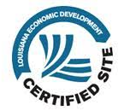

TESTIMONIALS
IEDC
NEXT LEVEL BUSINESS
SSI Program Experience: SSI Phase I for LED’s Economic Development Readiness (EDRED) Program. Site certification program development collaboration. Numerous successful industrial and commercial site selection projects.
“The SSI suitability model allowed us to find hundreds of quality candidate sites for the LED certified sites program. This accelerated the progress of the LED certified sites program which has provided Louisiana a robust inventory of development-ready sites and has led to high value project wins.”
Larry Henson
Director, Business Intelligence (Ret.)
The SSI Core Suitability Models allowed us to find hundreds of
quality candidate sites for the LED certified sites program.
STATE ECONOMIC DEVELOPMENT ORGANIZATION

Slide 18


TESTIMONIALS
IEDC
NEXT LEVEL BUSINESS
SSI Program Experience: SSI Phase I for megasite, heavy industrial, light industrial, heavy agribusiness, general agribusiness, distribution/freight logistics, R&D/tech, and business park/medical for fourteen counties across North Florida. SSI Phase II for twenty sites in NFEDP membership area.
“North Florida’s competitinvess in economic development has greatly increased through the SSI Program. The Leotta Location and Design team uncovered a surprising number of high-quality sites that now give our fourteen counties the real estate product we need to compete for quality jobs.”
Jeff Hendry
Executive Director
North Florida’s competitiveness in economic development has greatly increased
through the SSI Program. …we now have the real estate product we need
to compete for quality jobs.
REGIONAL ECONOMIC DEVELOPMENT ORGANIZATION

Slide 19


TESTIMONIALS
IEDC
NEXT LEVEL BUSINESS
SSI Program Experience: SSI Phase I for megasite, heavy industrial, light industrial, distribution/freight logistics, R&D/technology, and business park/medical for Glades County, Florida.
“SSI is an objective third-party site evaluation that takes the politics out of the site selection process. Its an objective process to advance only the most competitive sites to market”.
Tracy Whirls
Executive Director
SSI takes the politics out of the site selection process. Its an objective
process to advance only the most competitive sites to market.
LOCAL ECONOMIC DEVELOPMENT ORGANIZATION

Slide 20


TESTIMONIALS
IEDC
NEXT LEVEL BUSINESS
SSI Program Experience: Site selection for the Sasol, GTL and Ethylene Cracker facility (Mega Project) successfully competed and located in Lake Charles, Louisiana. SSI Phase I Core Suitability Models were utilized to rapidly identify initial areas of interest (AOI) based on Sasol’s Mega Project construction, operational, and distribution requirements.
“The site discovery technology provided by Louisiana Economic Development’s consultant was extremely useful to Sasol as a prospective investor. The EDRED (SSI Program) enabled us to select a suitable site for our proposed projects in record time and led to significant time savings on our tight project schedule.”
Johan van Buren-Schele
President, Sasol, Ltd.
North American Business Development
The SSI Program enabled us to select a suitable site for our proposed projects in
record time and led to significant time savings on our tight project schedule.
INTERNATIONAL CORPORATION

Slide 21
TESTIMONIALS
IEDC
NEXT LEVEL BUSINESS
Kevin Kieft
LIVE

Slide 22
TESTIMONIALS
IEDC
NEXT LEVEL BUSINESS
Marc Hoenstine
LIVE

Slide 23
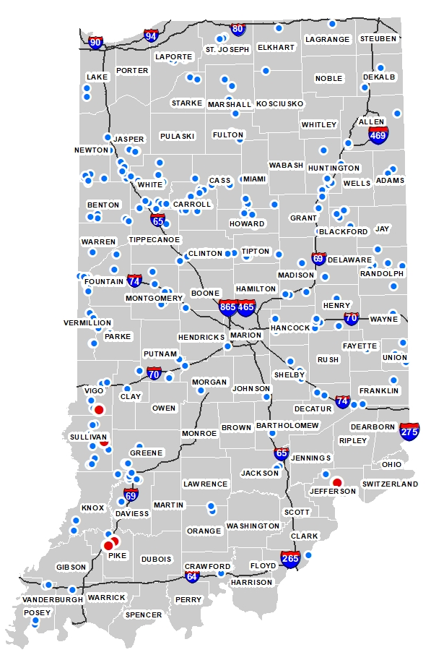
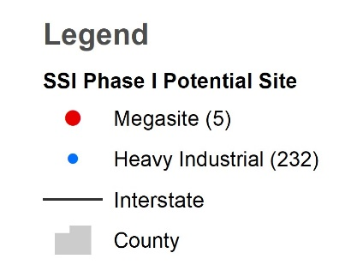
Community Competitiveness
IEDC
STRATEGIC SITES
INVENTORY PROGRAM
NEXT LEVEL BUSINESS
HEAVY INDUSTRIAL
Why we started here at Heavy Industrial and added Light Industrial and Ag to include all 92 counties.

Slide 24
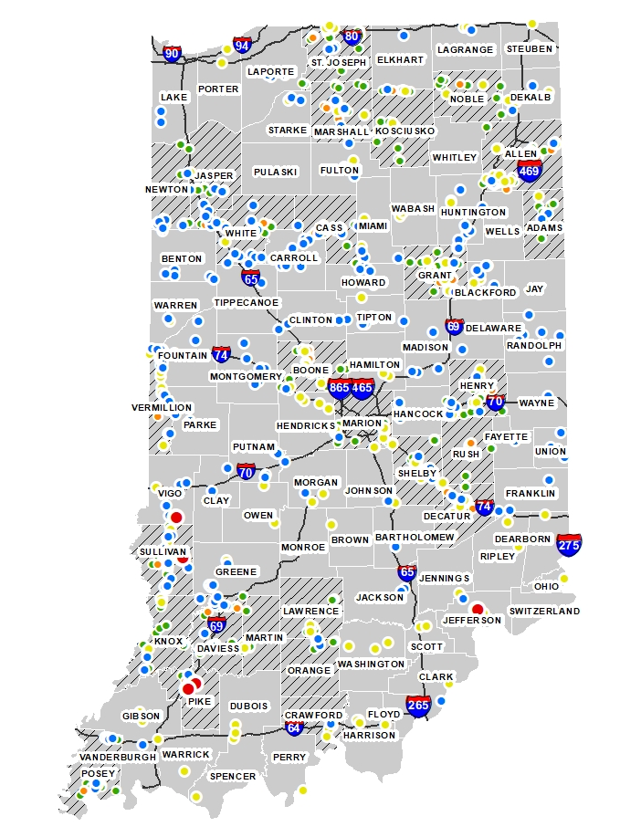
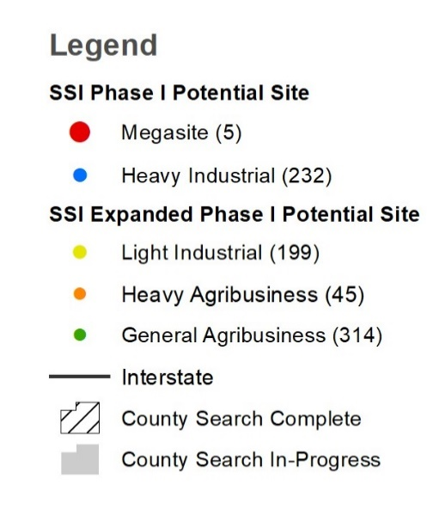
Community Competitiveness
IEDC
STRATEGIC SITES
INVENTORY PROGRAM
NEXT LEVEL BUSINESS
LIGHT INDUSTRIAL + AG
Substantially increases potential sites and will include sites for all 92 Indiana counties.

Slide 25
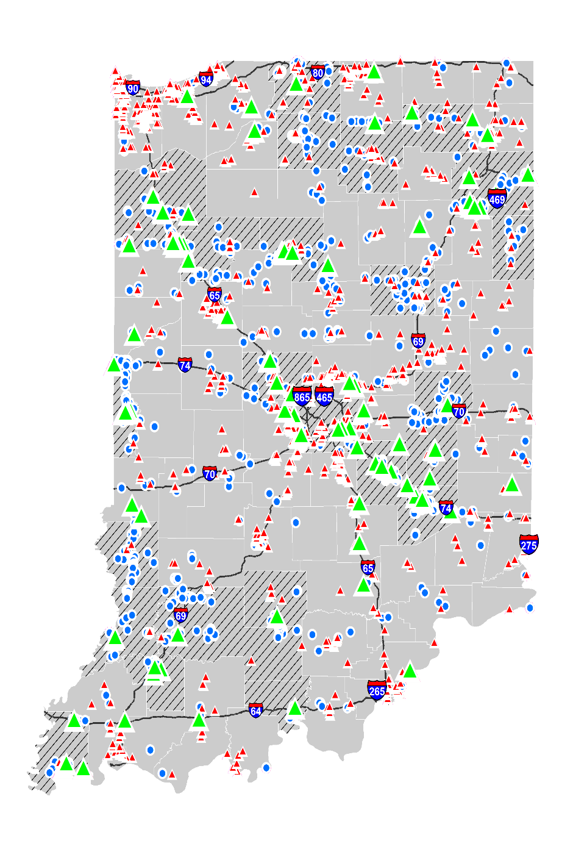
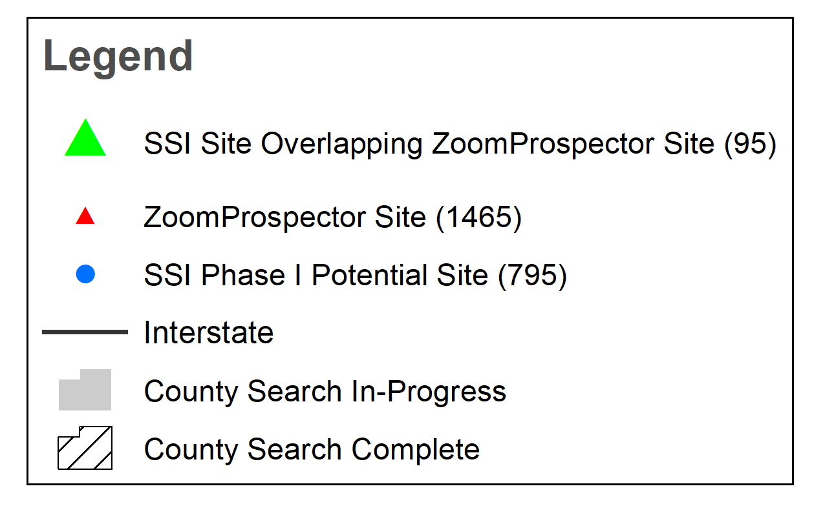
NOT IN ZOOM PROSPECTOR
NEW SITES
IEDC
NEXT LEVEL BUSINESS

Slide 26
  Q & A
  Led by Lee Lewellen, IEDC and Power Partners

Slide 27
IEDC
Q+A
NEXT LEVEL BUSINESS
We have a sites and building database and/or an established certified sites program. Why do we need the SSI Program?
The SSI Program does not compete with either existing site certification programs or sites and buildings databases. Rather, the SSI sites become high-survival feedstock for certification through existing site readiness programs. As well, SSI sites may be readily published to the open real estate market through preferred sites and buildings database platform.

Slide 28
IEDC
Q+A
NEXT LEVEL BUSINESS
Where do sites originate from for evaluating through the SSI Phase I process?
Unlike site certification programs around the country where sites are presented by EDOs, landowners, or real estate professionals for consideration, the SSI Program relies exclusively on mining potential sites through SSI Phase I: Site Discovery. Site discovery is informed by Core Suitability Model-driven site searches and screening against rigorous engineering, environmental, cultural, and infrastructure location metrics developed from 20+ years of industrial and commercial site selection experience.

Slide 29
IEDC
Q+A
NEXT LEVEL BUSINESS
Do you consider zoning in the selection of potential SSI Phase I sites?
Not during initial site searches and screening. We want the land to serve its highest and best economic development use which may not align with current zoning. Rezoning or zoning variances are addressed where required after the local EDO confirms landowner willingness to sell or lease property at a competitive price.

Slide 30
IEDC
Q+A
NEXT LEVEL BUSINESS
Do you consider labor in the selection of potential SSI Phase I sites?
Not during initial site searches and screening. SSI Phase I sites must first be reviewed locally and ranked for relative value as an economic development real estate asset. Priority sites are further studied within the context of local industry targets. Industry targets inform the occupational/job categories to select for a laborshed analysis. Where site characteristics and connectivity to transportation assets and utility infrastructure align with industry target location requirements, those sites become candidates for a cursory drive-time laborshed analysis. The drive-time laborshed analysis provides a general determination of total employment within apposite occupational/job categories sufficient to supply workforce for intended industry targets. The laborshed analysis is based on commercially-available data and is limited to a generalized evaluation of potential workforce availability. This is conducted subsequent to SSI Phase I, typically conducted in SSI Phase II: Preliminary Due Diligence.

Slide 31
IEDC
Q+A
NEXT LEVEL BUSINESS
Can we submit SSI Phase I sites for an RFI response?
Yes. As long as the site selection consultant and prospect are made aware that the landowner must be engaged to determine property availability and price. While not the ideal time to initiate landowner engagement, it is not entirely uncommon to reach an amenable property sale or lease agreement. Prospect must be willing to allow the time required for landowner contact and negotiations.

Slide 32
IEDC
Q+A
NEXT LEVEL BUSINESS
How many project land uses can you model for SSI Phase I site searches?
We currently apply the following Core Suitability Models for conducting SSI Phase I site searches:
Core Suitability Model. Total Acres. Min. Contiguous Buildable Acres
Megasite 1,000 600
Heavy Industrial 400 250
Light Industrial 150 75
Heavy Agribusiness 150 75
General Agribusiness 50 30
Distribution/Freight Logistics 75 50
R&D/Technology 20 15
Business Park/Medical 20 15
Each Core Suitability Model includes multiple transportation scenarios resulting in model subsets. Currently there are 24 Core Suitability Model subsets.

Slide 33
IEDC
Q+A
NEXT LEVEL BUSINESS
We have a local engineering and/or environmental consulting firm that supports our EDO. Can we use them to perform due diligence on SSI sites?
Absolutely. The SSI Program is design to create local consulting opportunities for site engineering and environmental due diligence, pre-engineering design, property appraisal and title research, real estate and entitlements legal services, and real estate brokering.

Slide 34
IEDC
Q+A
NEXT LEVEL BUSINESS
We have our own sites, why should we care if they complement sites in nearby jurisdictions?
Many times communities stRive to attract large-scale employment projects. However, communities may lack the workforce, transportation assets, and/or utility capacities to host a large project. If a regional economic development approach is taken in earnest, neighboring counties with the sites and capacity to host large-scale projects will often create many supporting projects that cannot compete in close proximity to the parent project. Proximate communities offering with quality sites outside the parent project laborshed may be in position to field smaller job-producing projects with comparable or better wages.

Slide 35
IEDC
Q+A
NEXT LEVEL BUSINESS
Do you consider Brownfields sites as part of SSI Phase I?
We do not. Typically SSI Phase I produced a sufficient number of viable sites that may be considered. Brownfields sites do not always carry environmental legacy liabilities but there is consistently negative perceptions regarding these properties on the part of buyers and/or their consultants.

Slide 36
IEDC
Q+A
NEXT LEVEL BUSINESS
Why aren’t you looking at listed properties?
The goal of the SSI Program is to ensure every property in a community with a highest and best use for economic development is identified, screened, and if competitive, advanced to the open real estate market. Sites current listed, regardless of quality, meet this goal. That said, LL+D routinely evaluates existing sites through the SSI Phase I site screening process to assign a qualitative competitive benchmark to currently listed industrial and commercial properties. The SSI Phase I benchmarking results provide objective, a-political insight into the viability of a community’s economic development real estate asset inventory. Potentially competitive sites are assigned primary and secondary project land uses to align with industry targets.

Slide 37
NEXT STEPS
  Local, County-Level Site Reviews
  Private meeting with Six County Stakeholders
  (1) Planning and Zoning
  (2) Engineering
  (3) Public Works
  (4) Permitting
  (5) County Administrator
  (6) County Floodplain Manager
  Purpose is to verify data with local and rank sites for economic development competitiveness–NO ON-SITE ANALYSIS OR EXPENSE

Slide 38
NEXT STEPS
  Call to Action for Counties
  Get your county at the front of the list potential site identification
  2) Contact Sarah Salisbury to help organize local, county- level site review meetings

Slide 39
NEXT STEPS
  Timeline and Key Dates
  Heavy Industrial Identification - COMPLETE
  Batch 1-3 site identification for Light Industrial and Ag – COMPLETE
  Batch 4-10 site identification for Light Industrial and Ag – date
  First local, county-level site review workshop – date
  Last local, county-level site review workshop - date

Slide 40
STRATEGIC SITES INVENTORY PROGRAM OVERVIEW
SSI PROGRAM CONDUCTED BY

